Slide 1



KEYPAD-CONTROLLED ELECTRONIC LOCK SYSTEM
PRESENTED BY
Srinithi S(22ECR188)
Sriraamkarthick S(22ECR189)
Sriram V(22ECR190)
Department of Electronics & Communication Engineering
1

Slide 2

Problem Statement
Key Points:
Access Control Challenges: Security concerns with conventional lock systems.
Manual Locking/Unlocking Issues: Potential for unauthorized access, forgotten keys, and the need for physical presence.
Existing Lock Systems: Lack of advanced features like remote access or password management.
Need for Automation: Demand for a more secure, automated, and easy-to-use locking mechanism.

Slide 3
INTRODUCTION
Purpose: Introduction to the concept of electronic lock systems and their importance in security.
Key Points:
Traditional lock and key systems are becoming outdated and inefficient.
The need for digital systems that offer higher security and convenience.
Electronic locks offer flexibility, enhanced security, and easy integration with other systems.
Overview of the PIC16 microcontroller as a suitable platform for embedded system development.

Slide 4
Existing method
Mechanical Locking Systems:Depend on physical keys for operation.
Vulnerable to lock-picking, key duplication, and loss.
Basic Electronic Lock Systems:Use simple keypads but lack advanced features like encryption or user management.
May not be easily scalable or customizable.
Limitations:Lack of flexibility for multiple users.
Inadequate security (vulnerable to brute force or unauthorized access).

Slide 5
PROPOSED METHOD
PIC16 Microcontroller-based Solution:A microcontroller-based keypad entry system offers a more secure, user-friendly solution.
Password-based access control for enhanced security.
Use of digital signals for controlling the locking mechanism.
Scalable for multiple users and easy to modify.
Features:Secure PIN entry.
Lock status indication (open/closed).
Easy-to-use interface with a 4x4 matrix keypad.
Possibility for password updates.

Slide 6
Design/Algorithm
Algorithm:System initializes, and the keypad is ready for input.
User enters a 4-digit PIN using the keypad.
The microcontroller processes the input and compares it with the stored PIN.
If the PIN matches, the lock is released (via relay).
If the PIN is incorrect, a failure message is displayed, and the lock remains engaged.
The system resets after a time delay or user input.

Slide 7
Components used
PIC16 Microcontroller:
The heart of the system, which controls all operations.
Performs input processing, PIN validation, and lock control.
4x4 Matrix Keypad:
Used for entering a 4-digit PIN code.
Allows the user to input commands for locking/unlocking the system.
LCD Display (16x2):
Provides user feedback during the operation of the lock system.
Displays messages such as "Enter PIN," "Lock Open," "Incorrect PIN," etc.
LED Indicators:
Green LED: Indicates that the lock has been successfully opened.
Red LED: Indicates that the PIN entered was incorrect or the system is in a locked state.
Resistors and Capacitors:
Resistors are used for debouncing the keypad inputs.
Capacitors stabilize the voltage levels and filter noise in the power supply.
Power Supply (5V DC):
Powers the microcontroller, keypad, LCD, and other components.
Provides a stable voltage for reliable operation.

Slide 8
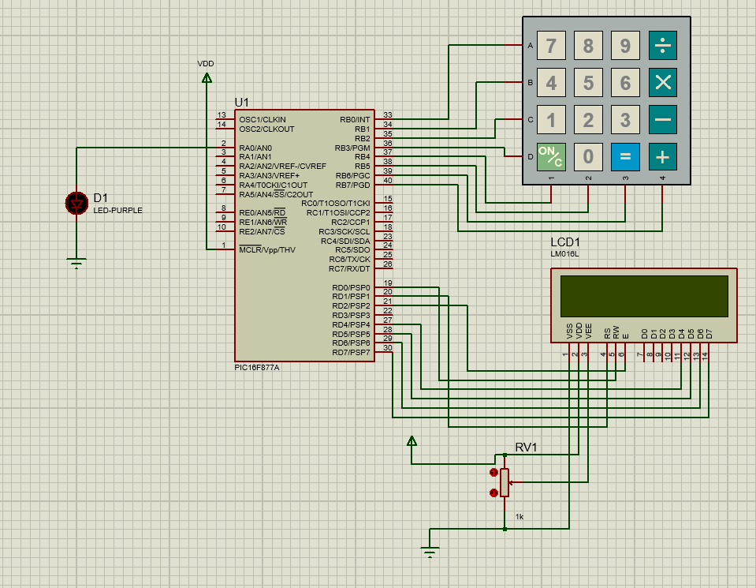
CIRCUIT DIAGRAM

Slide 9
Application
Home Security Systems: Use in residential door locks for secure access.
Office/Building Security: Control access to restricted areas using PIN-based entry.
Industrial Automation: Secure access to machinery or control panels.
Automated Systems: Integration with other security systems for complete access control.
Smart Homes: Part of an integrated home automation solution.

Slide 10
CONCLUSION
The PIC16-based keypad-controlled electronic lock system is a secure, flexible, and scalable solution for access control.
It overcomes the limitations of traditional lock systems and provides an efficient, user-friendly alternative.
Future enhancements can include features like multi-user access, mobile control, and wireless integration.

Slide 11
THANK YOU

